Slide 1


PYTHON PROJECT
NYC Open Data: Motorcycle Collisions
Presented by Angelica Vera

Slide 2
about the dataset
We will explore NYC Open Data: Motor Vehicle Collision - Crashes data that is available to the public.
This large dataset contains information collected by the NYPD of all motor vehicle crashes in New York City.
Police officers fill out a form called MV-104AN whenever there is an accident that causes injury, death, or at least $1000 worth of damage.
This information is stored in a database and can potentially be used to improve traffic safety.
The data set goes all the way to 2023 but I will be using the data from 2016-2022 since they are the available complete years.
It is important to note not everybody reports their accidents to the police.

Slide 3


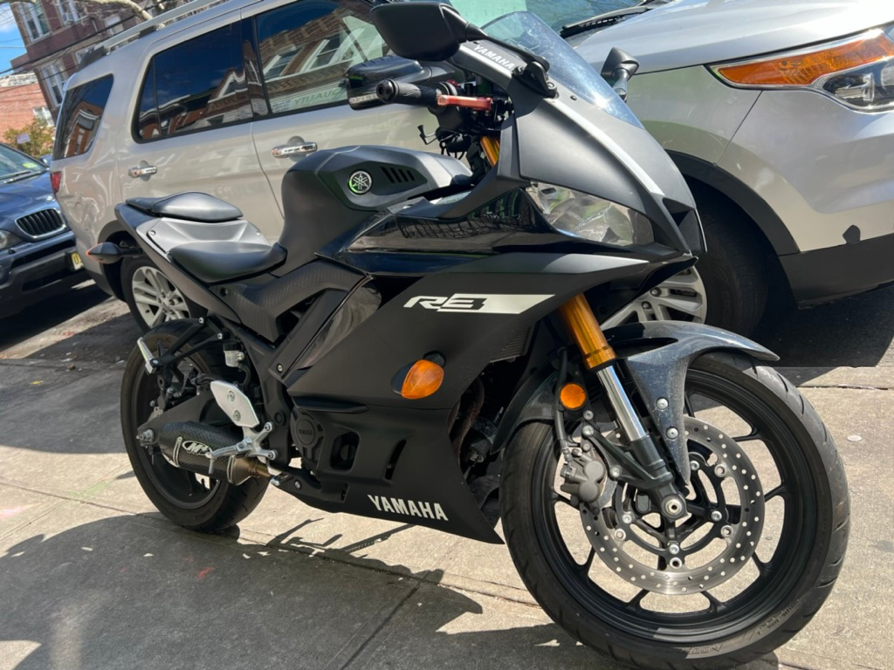
MY YAMAHA R3
I am interested in what the dataset tells me about motorcycle collisions in NYC.

Slide 4
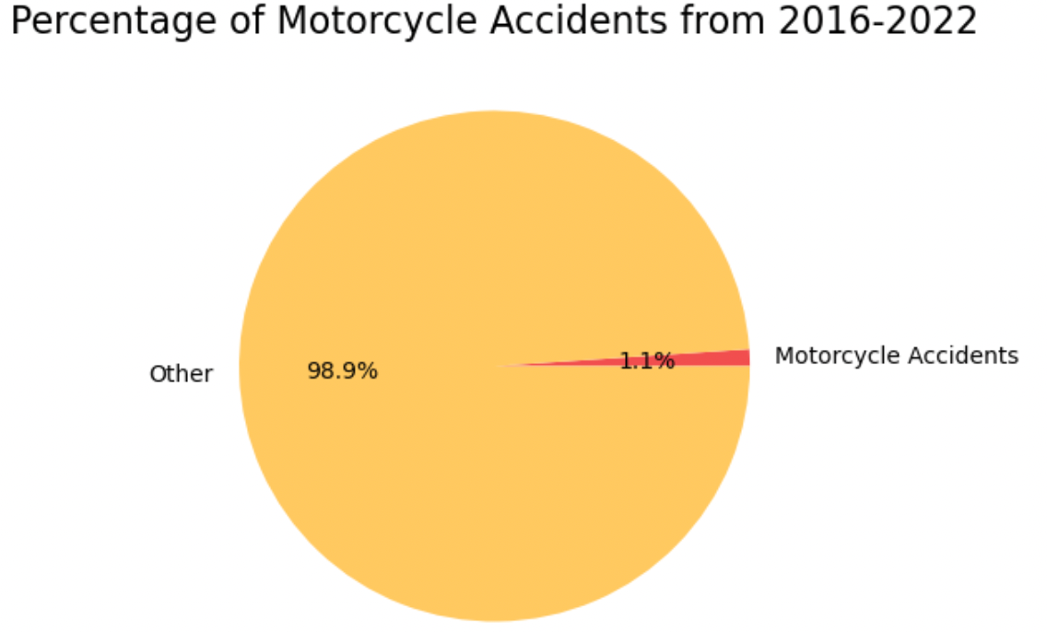
Motorcycle accidents from 2016 to 2022: 1.1% of all accidents.
In other words, 1 in 100 accidents involves a motorcycle.
This statistic becomes more concerning when considering that motorcycles constitute only 2% of registered vehicles in NYC, as reported by the DMV.

Slide 5
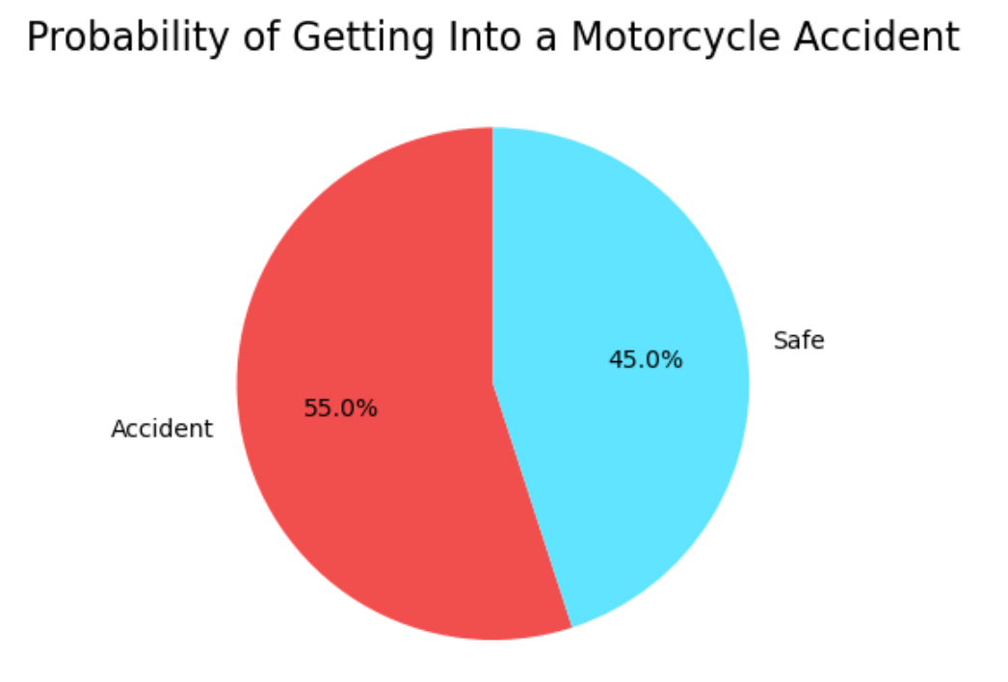
The risk of accident is high. More of less like flipping a coin.
Definitely not the safest mode for transportation. I would not rely on a motorcycle for everyday use.

Slide 6
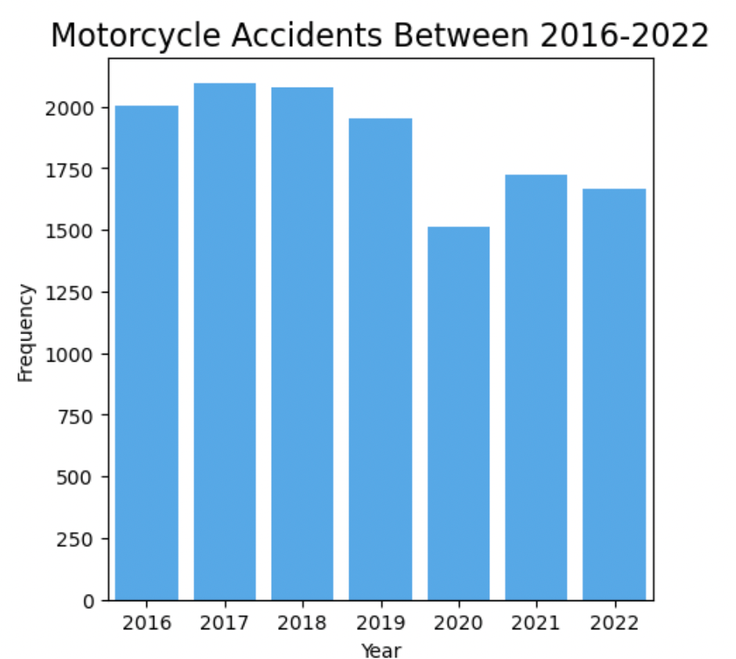
Motorcycle accident occurrences were the highest in the year 2017.
There was a dip in accidents in 2020, most likely due to the COVID-19 outbreak. With fewer people outside, there was less opportunity for accidents to occur.
The frequency of accidents has not returned to previous levels.
The dataset was produced specifically to improve traffic safety which could also explain the decrease in accidents.
To make a conclusive and confident assertion about the positive changes, we would need more years of data to see if frequency of collisions will rise or reduce.

Slide 7
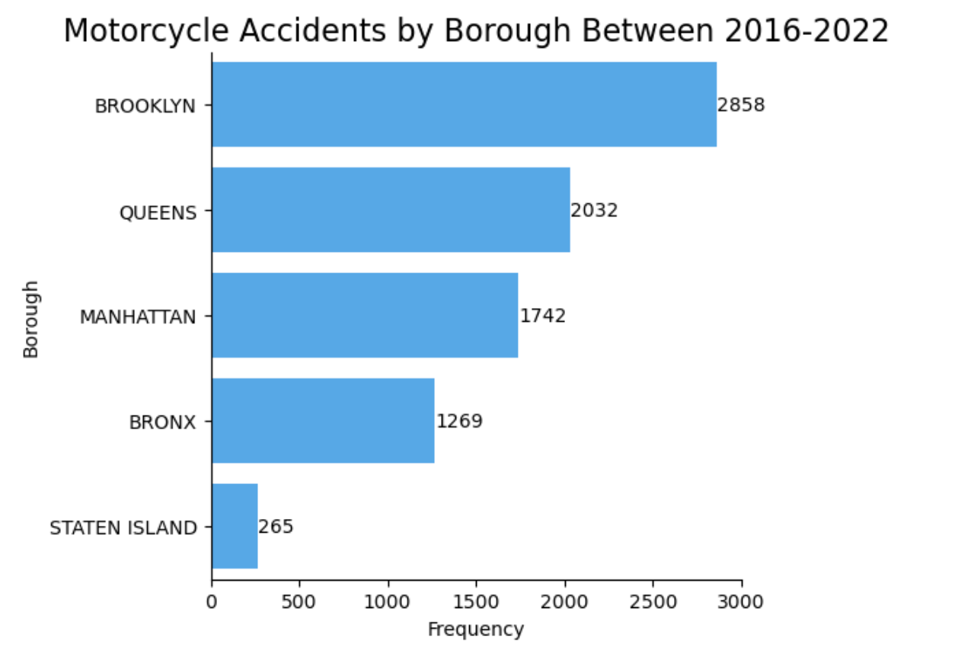
The highest number of accidents occurs in Brooklyn, followed by Queens.
This finding was surprising, as the assumption was that Manhattan would have the highest number of accidents due to congestion, crazy rush hours, and the presence of taxis known for reckless driving.
Population size may be a contributing factor, as Brooklyn is the most populous borough, followed by Queens and the respective boroughs.
With more population, there are more people on the roads, increasing the opportunities for accidents to happen.
**It's important to note that null values were removed from the data to ensure accurate analysis.

Slide 8
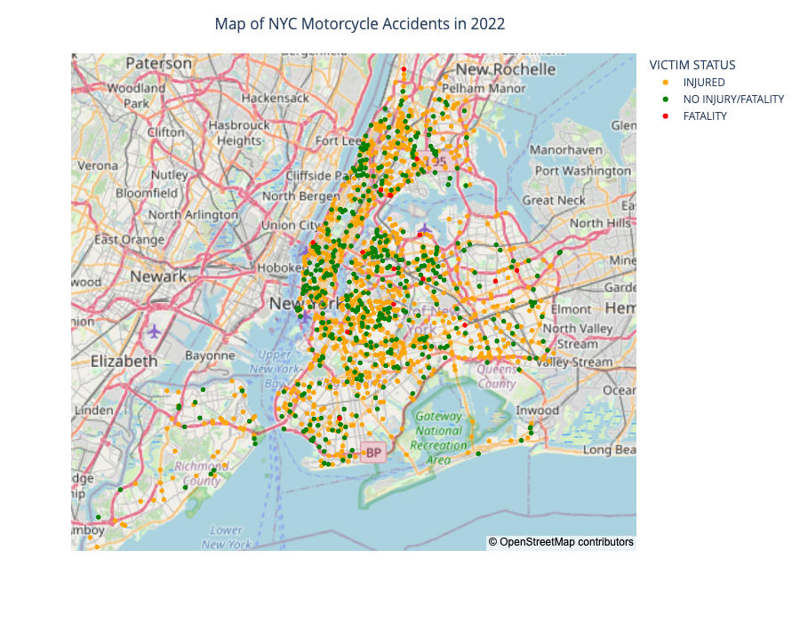
Most accidents are happening on city streets.
Brooklyn has more streets compared to Manhattan and fewer highways, providing more opportunities for accidents to occur.
Fatalities are more likely to happen on highways/expressways or busy avenues.
Contributing factors to fatalities on these roads may include higher speeds and increased vehicle density.

Slide 9
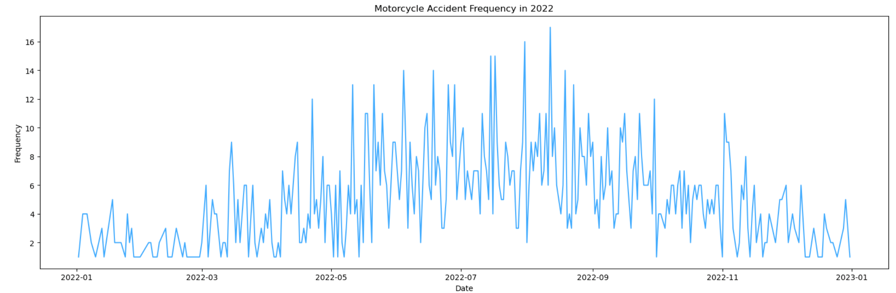
In the warmer months of the year, there are more frequent spikes in motorcycle accidents, with the highest spike reaching 17 accidents in a single day in August 2022.
This can be attributed to the fact that people prefer to ride motorcycles during warmer months when the weather is more comfortable, leading to an increased chance of accidents.
In the colder months, there are significantly fewer spikes in motorcycle accidents, with the frequency generally staying below the 10 mark.

Slide 10
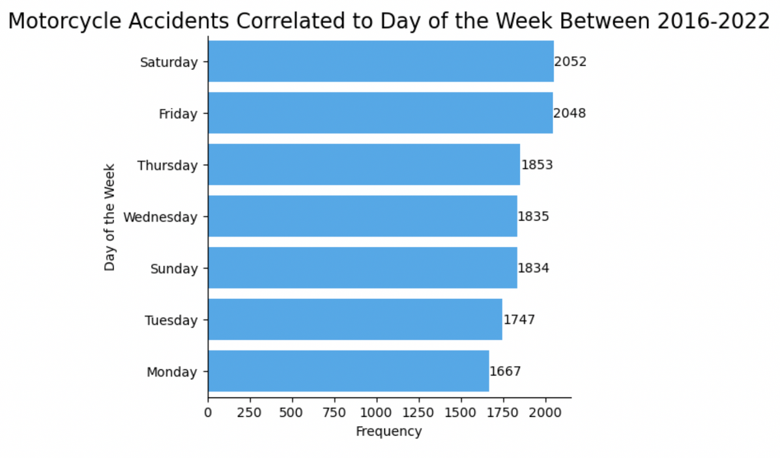
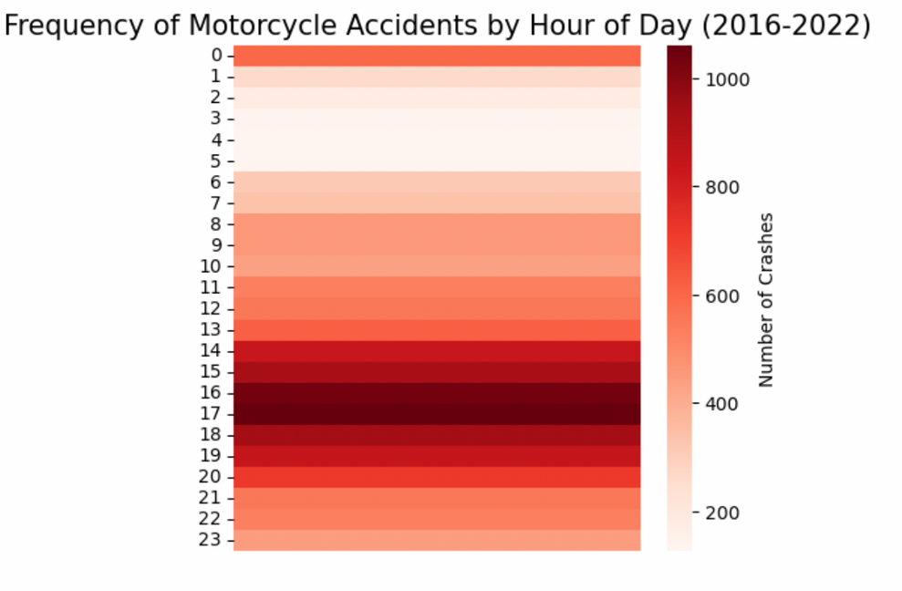
Friday and Saturday have the highest number of accidents compared to other days of the week. This can be attributed to the fact that these days are popular for socializing and going out, leading to increased alcohol consumption and a higher likelihood of more vehicles being out.
The heat map indicates that the darker shades of red represent higher accident frequencies. The darkest shade appears between 4-5 pm, which coincides with rush hour. During this time, there are more vehicles on the streets, increasing the opportunity for accidents to occur.

Slide 11
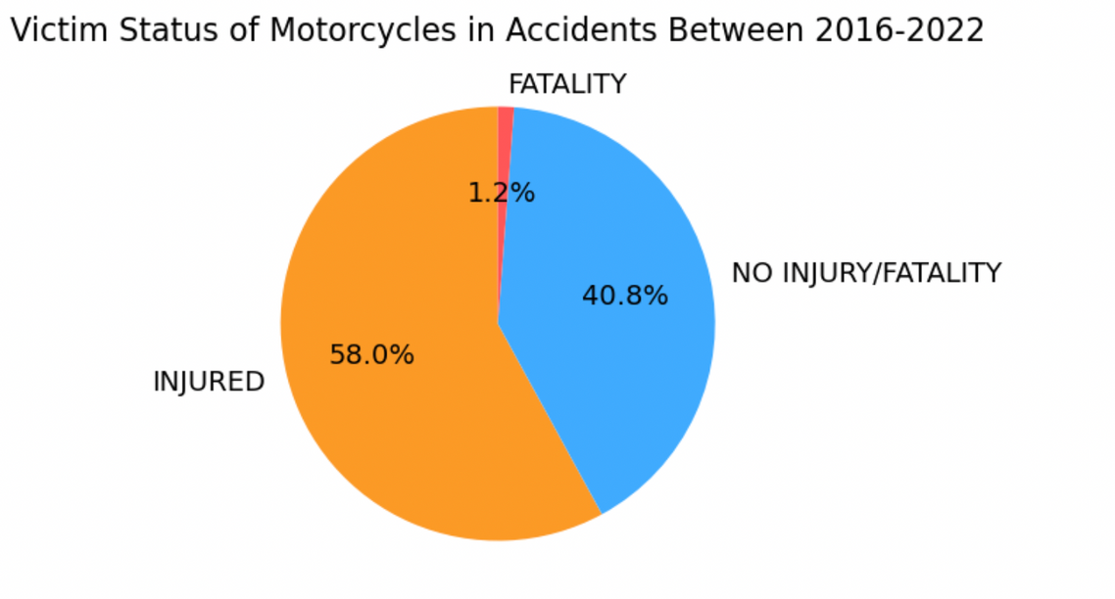
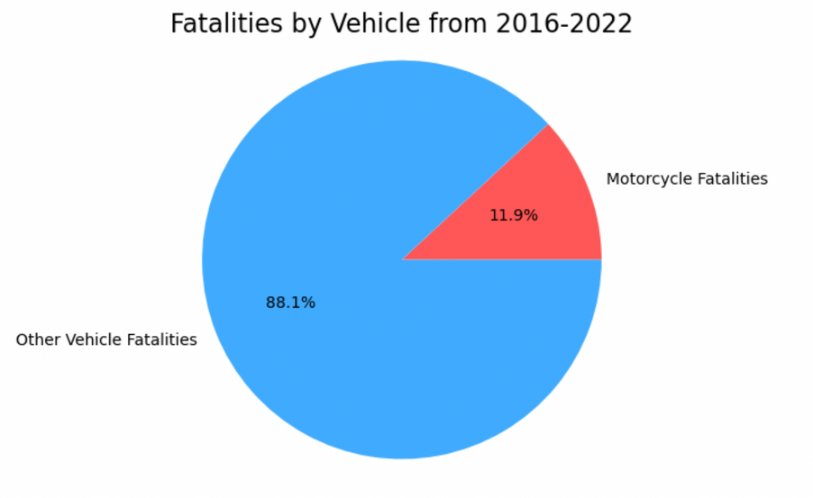
Motorcycle fatalities, although relatively low in number, account for nearly 12% of all vehicle fatalities in NYC. This is a significant proportion considering that motorcycles make up only 2% of registered vehicles.
Despite the lower fatality rate, most motorcycle accidents result in injuries.

Slide 12
Conclusion
Riding a motorcycle carries a high level of risk.
Motorcycle fatalities account for nearly 12% of all vehicle fatalities in NYC, despite motorcycles comprising only 2% of registered vehicles.
Accidents are prevalent across various locations, but extra caution is advised on highways, expressways, and busy avenues where more fatalities occur.
The majority of accidents happen during the warmer months, weekends, and rush hours. Opting for rides in cooler months, weekdays, and morning hours can reduce the risk.
Getting into a motorcycle accident doesn't necessarily mean a fatality, but the risk for injury is higher compared to no injury.
Being a defensive driver is crucial when riding a motorcycle. It is essential to wear protective gear for personal safety.

Slide 13
THANK YOU

